Slide 1
Status of NFPSS MX Beamlines at SSRF
Wenming Qin
National Facility for Protein Science in Shanghai (NFPSS)
/Shanghai Synchrotron Radiation Facility (SSRF)
November, 2023

Slide 2
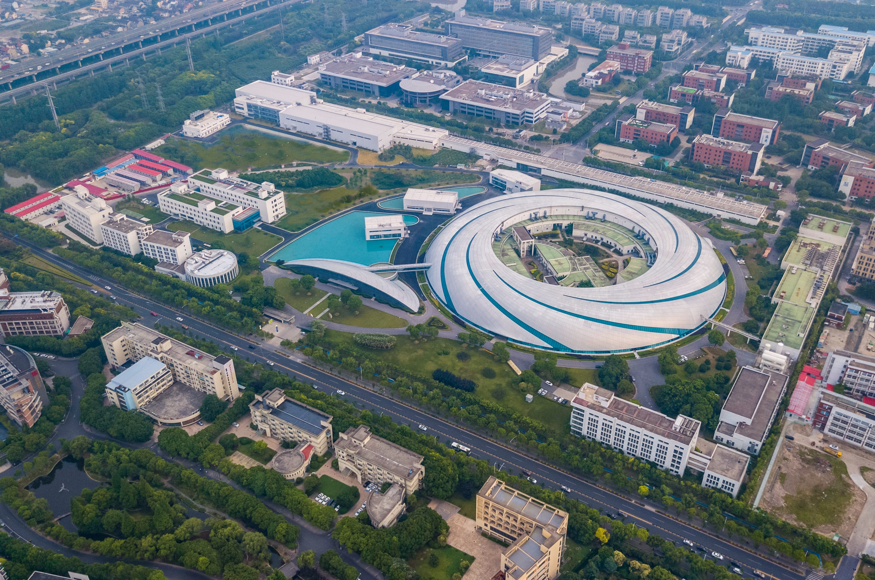
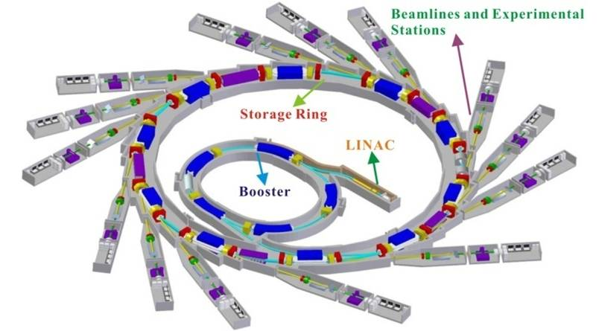
Shanghai Synchrotron Radiation Facility
SSRF Ring Parameters
Electron Energy：3.5 GeV
Electron Current: 300 mA
Circumference: 432 m
Straight sections: 20
Hard X-ray Free Electron Laser
Soft X-ray Free Electron Laser
SSRF

Slide 3

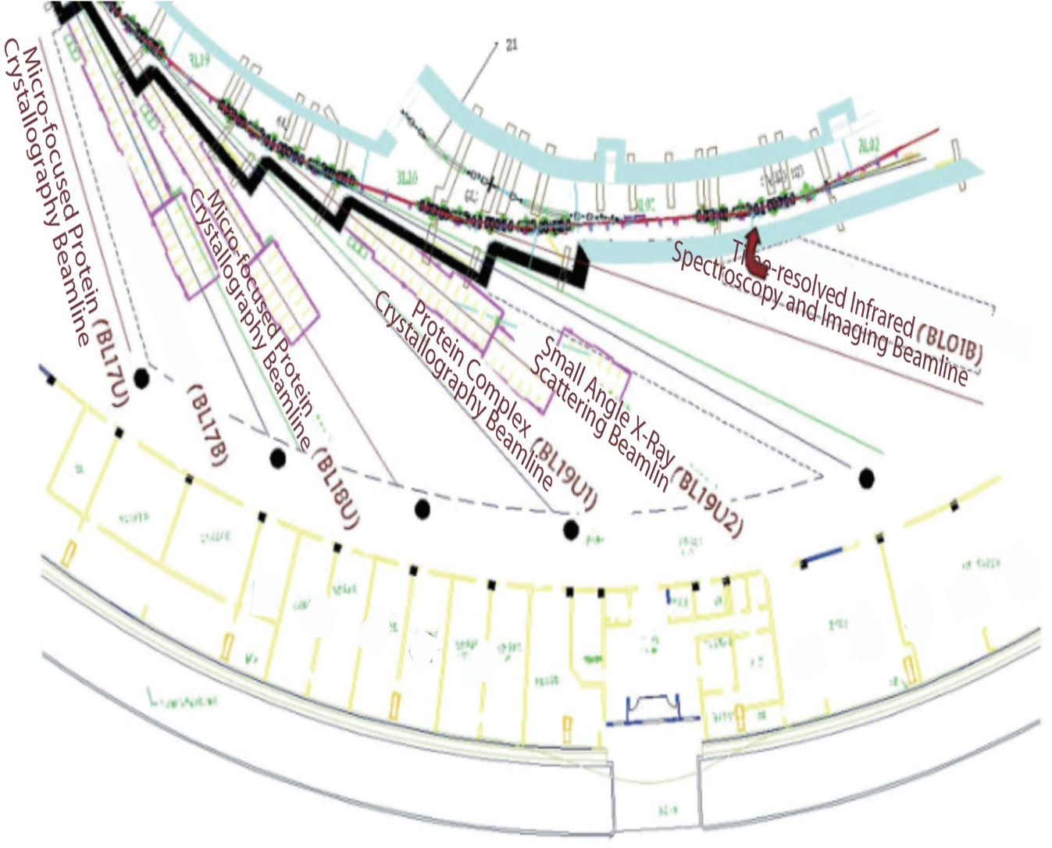
National Facility for Protein Science . Shanghai
NFPS passed the National Acceptance Review, and formally opened to the users in July 2015.
NFPS is composed of 9 technology systems with state-of-the-art instruments in its Haike Road Campus and 5 Beamlines within the Shanghai Synchrotron Radiation Facility.

Slide 4
MX Beamlines at SSRF
MOF/COF, GIWAXS, XANS
BL17B
6 MX Beamlines
BL18U1
NFPSS
MXCube
BL19U1
Shanghai Tech
BL17UM
BL02U1
SSRF
BL10U1

Slide 5
MXCUBE Status
We are still at the very beginning!
What we did
What we improved
What we are planning to do

Slide 6
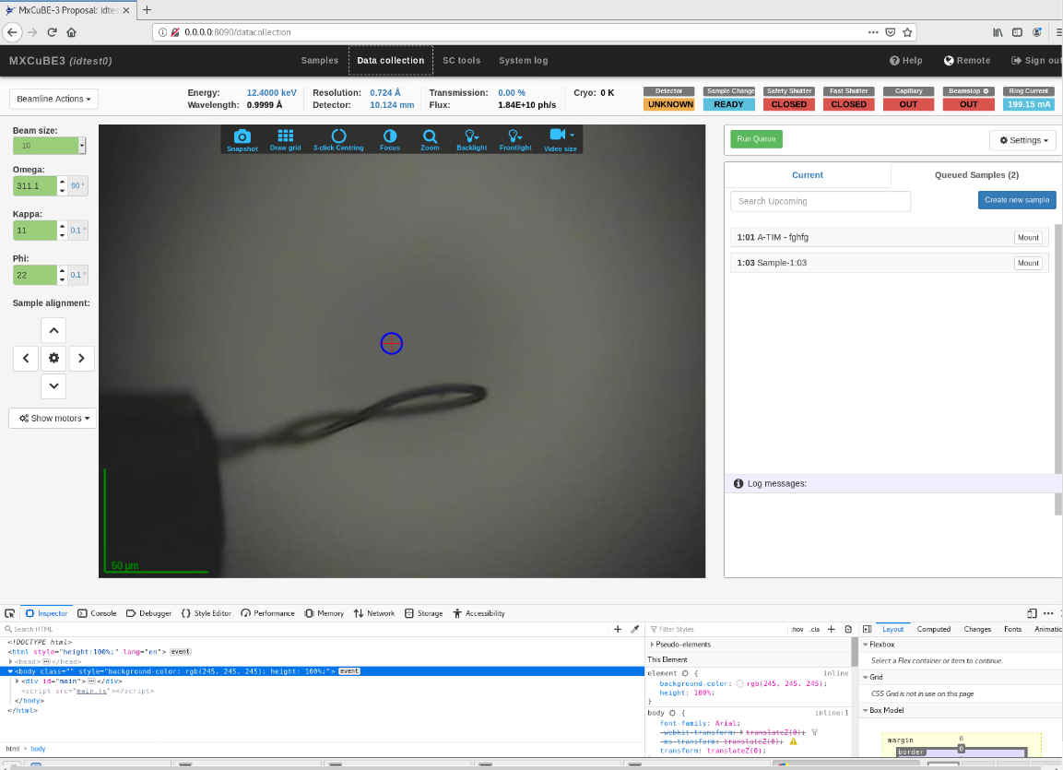
What We Did
MXCube3 at BL17B and BL19U have opened to users from Feberary, 2023 and June, 2023
MXCube 3 installed in virtual system
Exporter with MD2 in virtual system
EPICS-Pilatus with Pilatus3S-2M/Pilatus3-6M detector
EPICS for Energy，Fluo-detector，Detector distance，Ring Current、Intensity
Frame monitor and autoload with ADXV by monitoring the temp files in /lima_data directory
Data auto processing pipeline with XDS, autoproc xia2-dials.
Control the Actor sample changer system with socket communication
Replaced with braggy

Slide 7
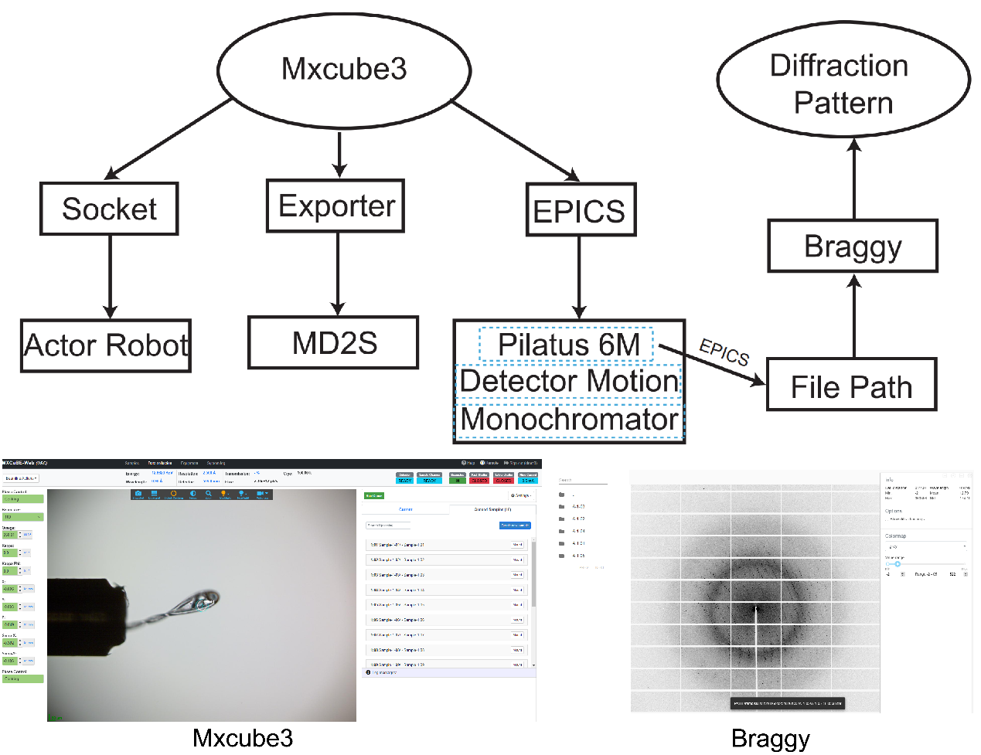
MXCUBE3 Interface and Communication Protocols Among Hardware Components with Diffraction Results Displayed in BRAGGY

Slide 8
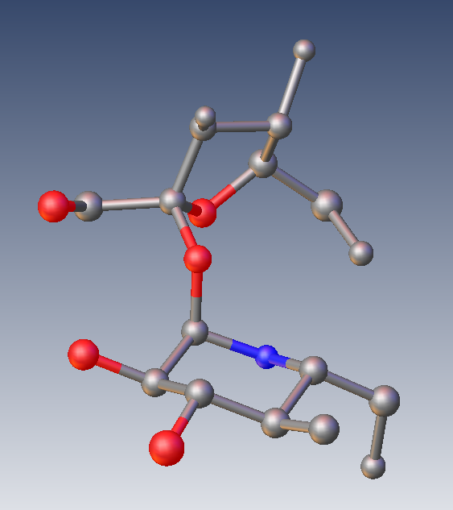
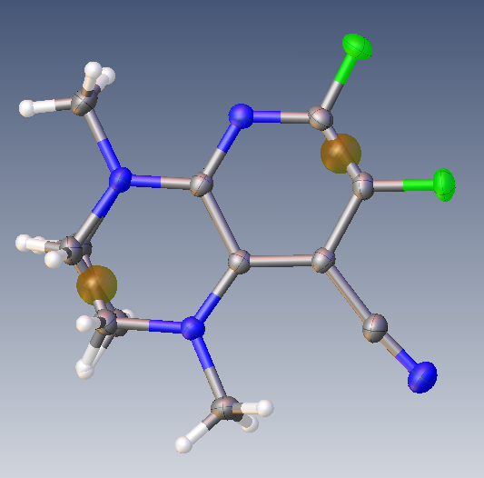
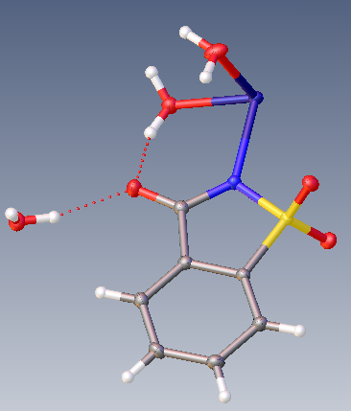
Pipeline of Data Processing and Structure Analysis
for small molecular crystals
DATA Process
Structure Analysis
MySQL
Xia2-xds
autoPROC
format conversion
ShelXT
Data collection
Ins file
HKL file
ShelXS
Xia2-dials
ShelxD
.........

Slide 9
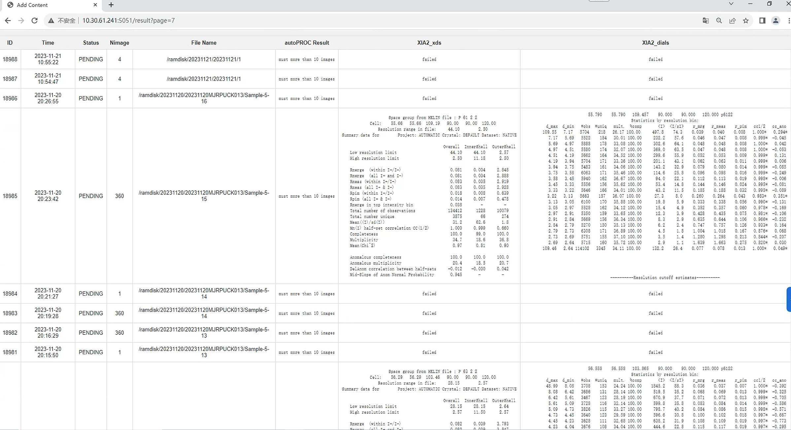
Web page of Data Processing result

Slide 10
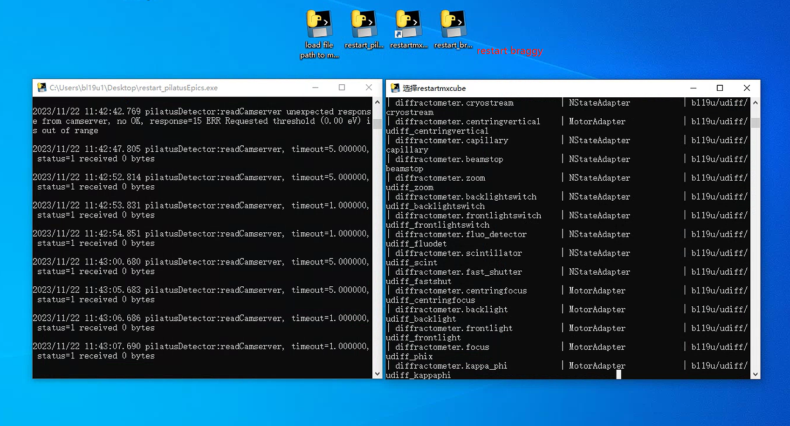
Auto restart mxcube program
Some restart shortcut on the desktop in order to allow users do the reset work themselves

Slide 11
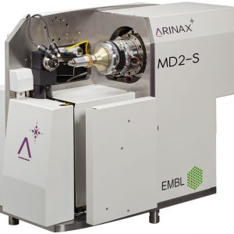
What progress we made from last meeting in May
Operating and improving the mxcube3 at BL19U1 by fixing bugs.
Replaced the adxv image viewer with braggy system.
Replaced the MD2 with MD2-S.
Allow users to load there own sample information by an excel file into mxcube before data collection.
ISPyB installation and configuration of python version

Slide 12
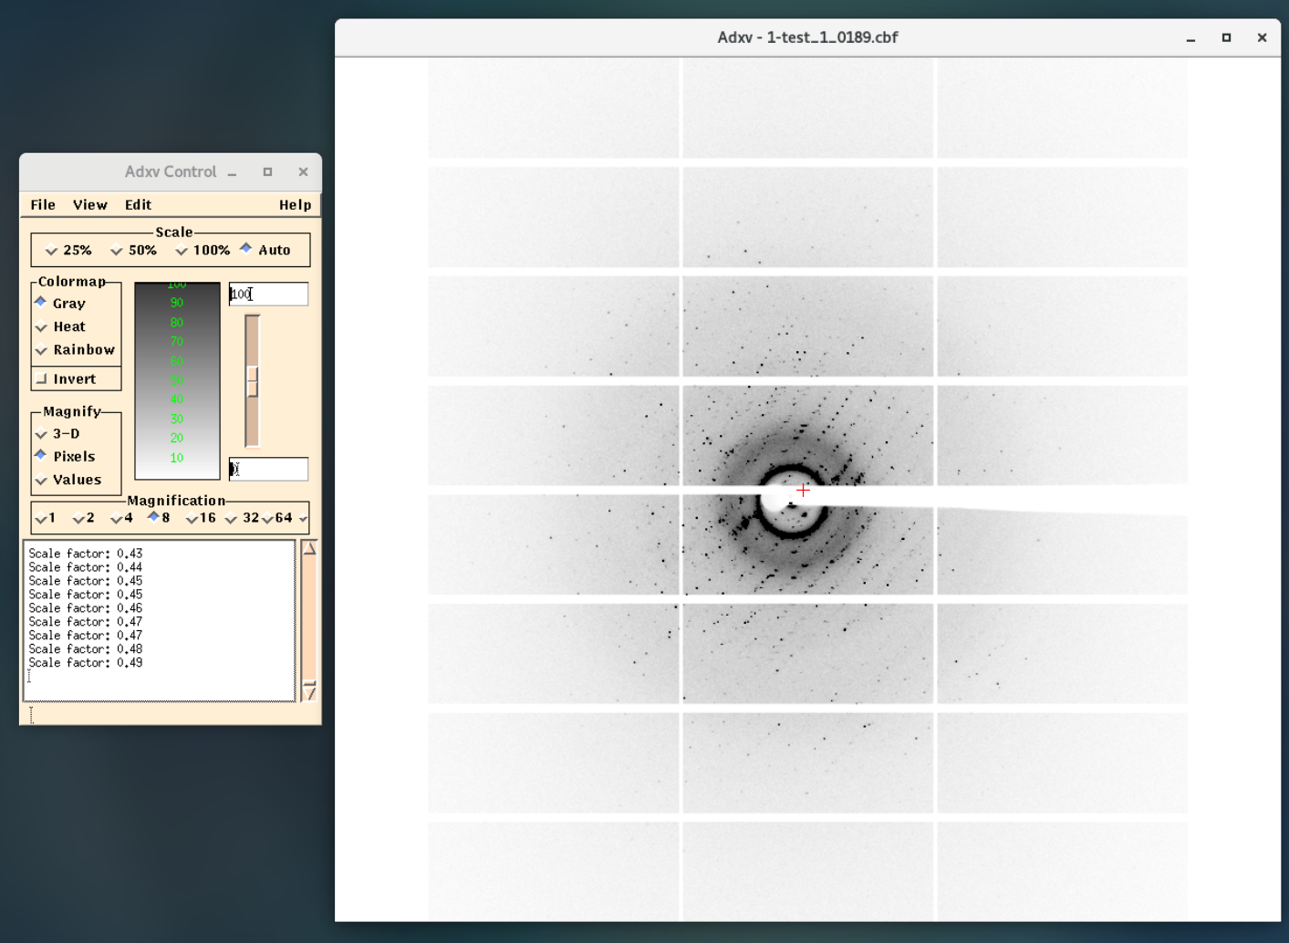
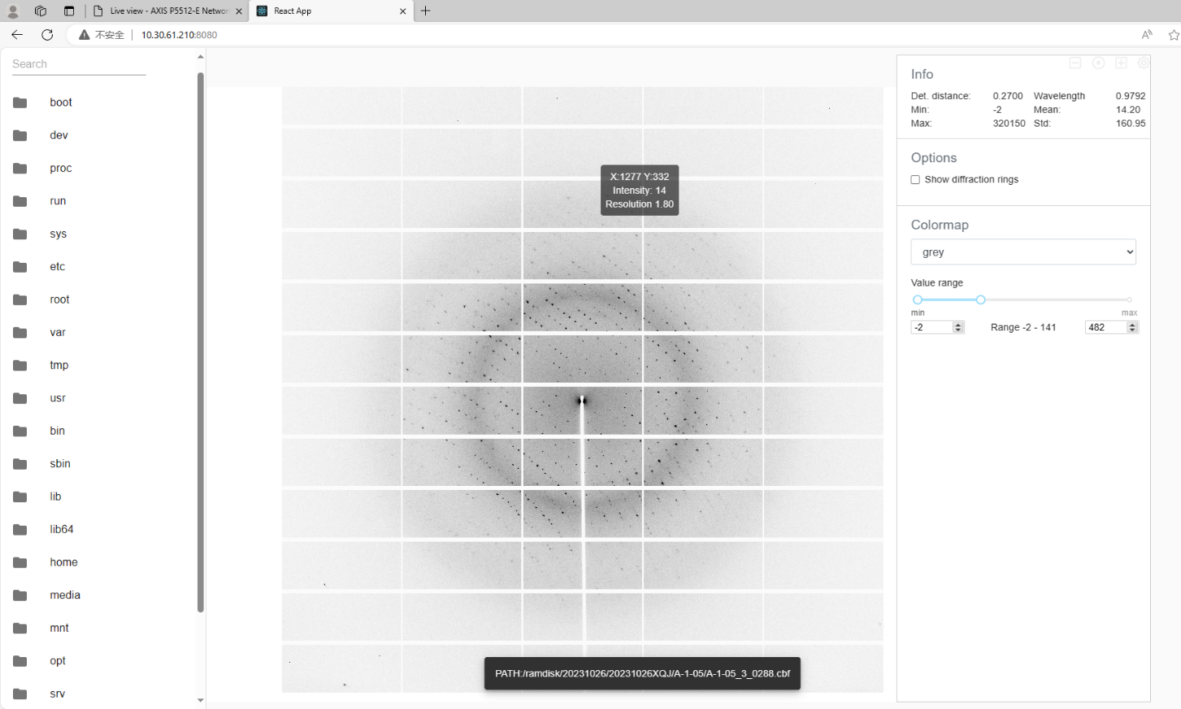
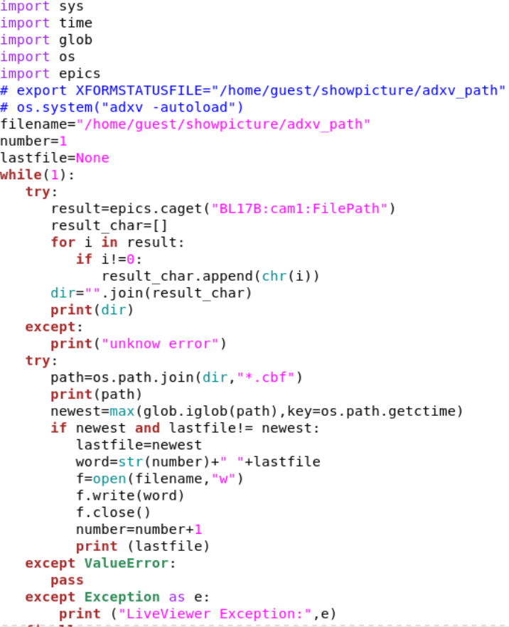
Live view of the diffraction images based on Braggy web page
Get the FilePath through EPICS
Tracing the latest image with Braggy

Slide 13
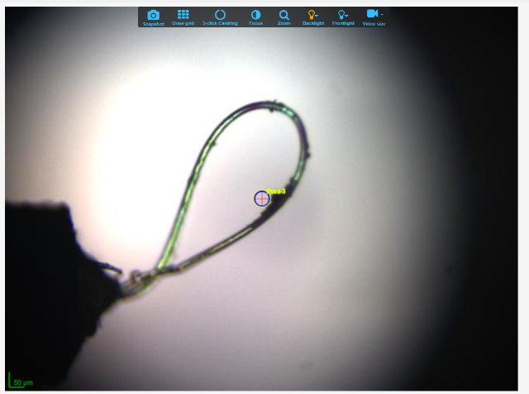
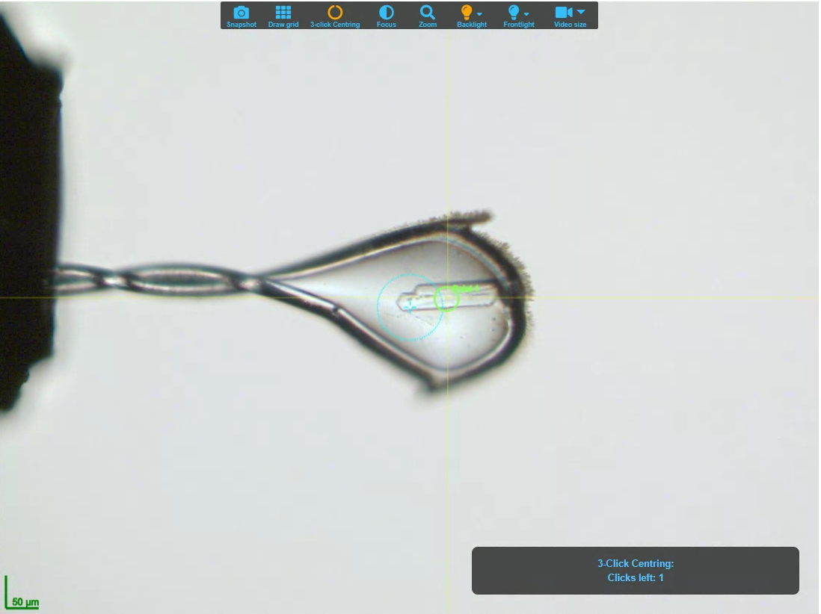
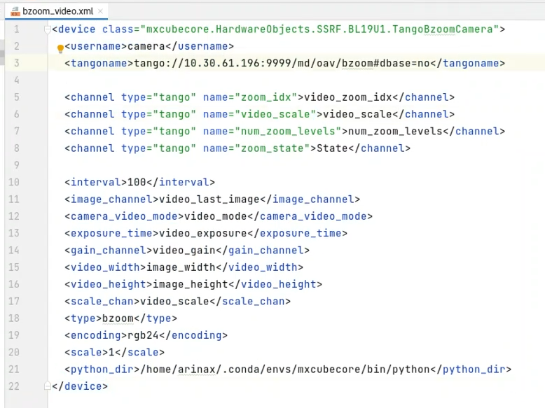
Using tango to poll the image from video-server of MD2-S
the video is clearer and smoother
with the B-zoom than before.
Thanks to Bernard from Arinax, the B-zoom camera is Integrated with tango
(getjpeg at BL17B with exporter)

Slide 14
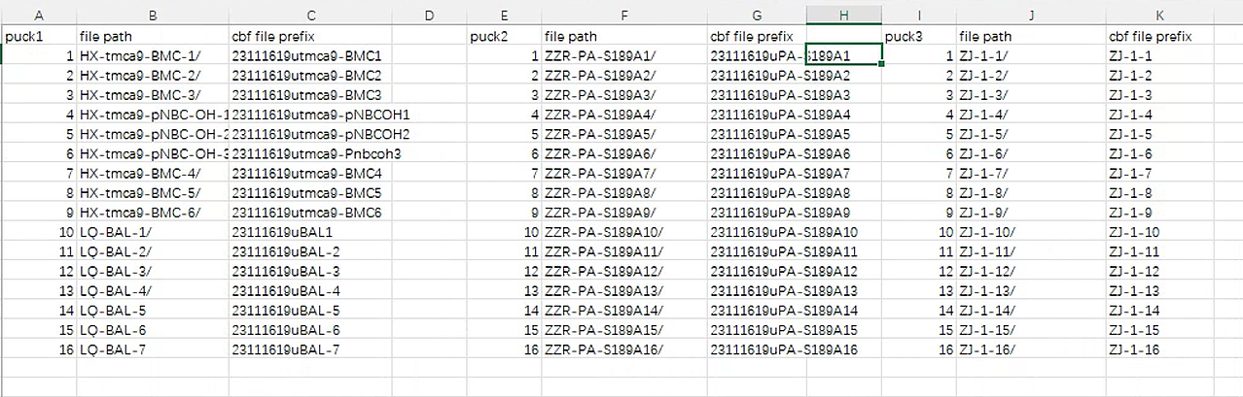
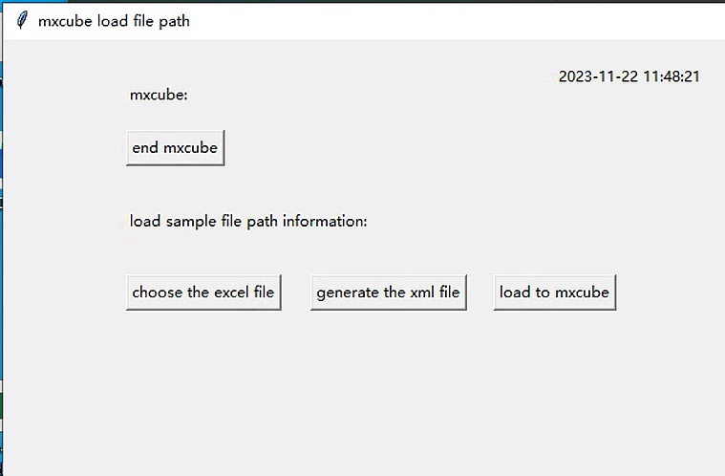
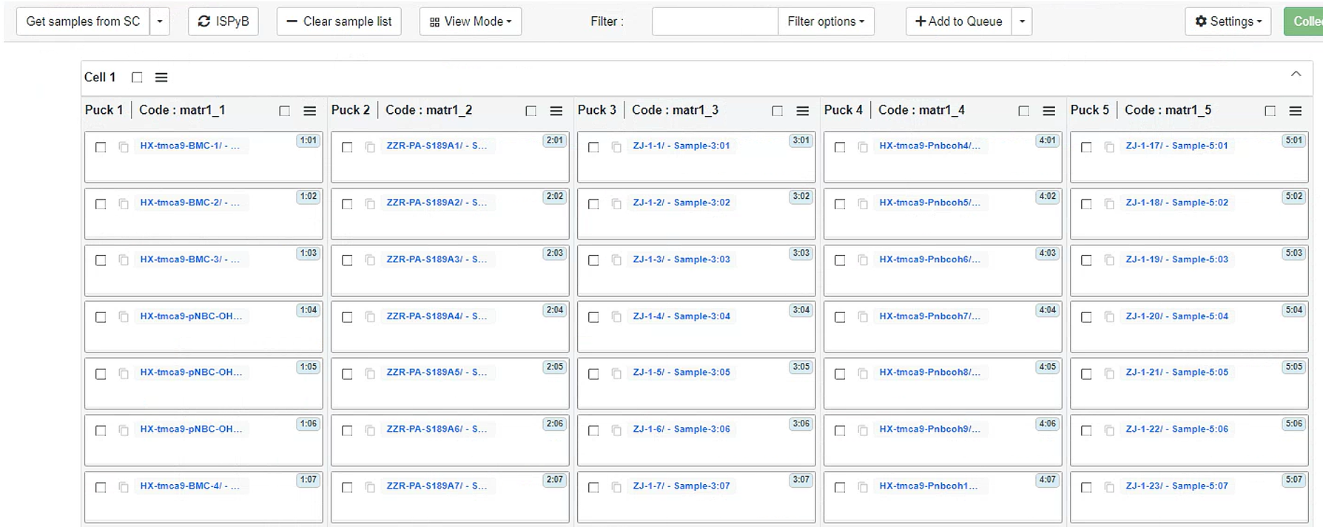
Loading sample file path information in advance
By using python tkinter program

Slide 15
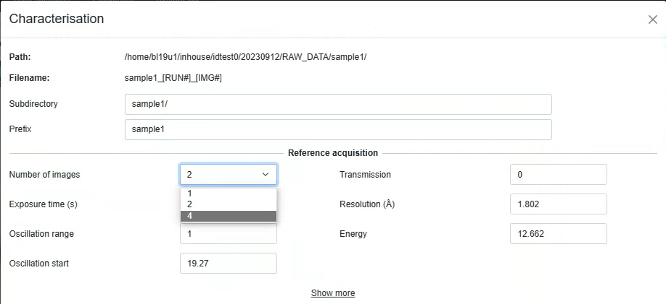
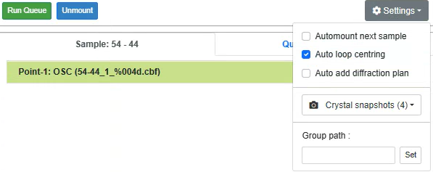
More features of Mxcube are implemented
1. Customized collection
2. Auto loop centering

Slide 16
ISPyB
Java version is used to get the basic function
ISPYB version：
  1. java √
    Full-featured
    ISPYB
      Backend Server
    EXI
      GUI
    LDAP
      Authentication
  2. Python
    Functionality in development
https://github.com/ispyb/py-ispyb
https://github.com/ispyb/py-ispyb-ui
https://github.com/ispyb/ISPyB
https://github.com/ispyb/EXI

Slide 17
Project progress
1. Database Configure
  In debugging, it was found that some tables are required, but they are deleted in the database script.
2. LDAP Configure
3. ISPYB compiled and deployed in WildFly application Server
4. Mxcube now can login by Ispyb service.

Slide 18
Software Architecture
ISPyB database

Slide 19
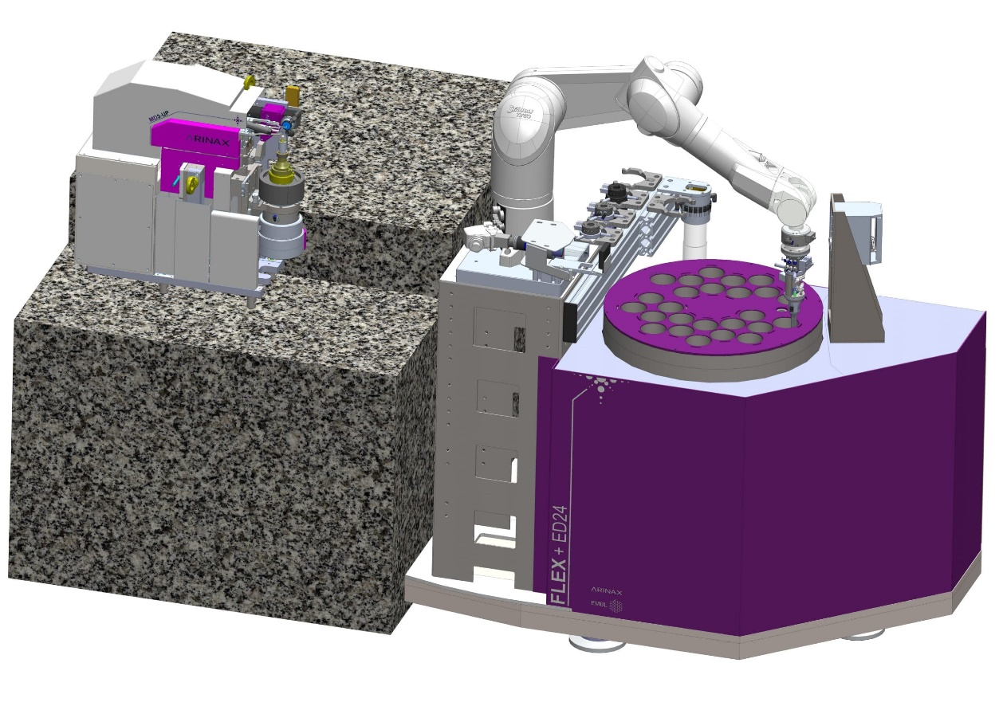
What We are Planning to Do
FLEX-ED35 will be installed at BL19U1 next year.
Complete the configuration of ISPyB and connect the database with MXCuBE.
Complete the function of automatic sample mounting, centering and collection.
Set up mxcube at BL18U1
FLEX-ED35

Slide 20
Thank you for your attention!
Acknowledgments:
- Shanghai Sychrontron Radiation Facility
- Mikel Eguiraun and Jie Nan from MAX IV
- Letícia G. Capovilla from LNLS
- Arinax, Dectris, Rigaku, Irelec
- MXCube community.

